Slide 1
Advanced Heart Health Assessment through Machine Learning
PIP104 University Project-II
Review-2
Batch Number:
Under the Supervision of,
Dr Prakash Shanmurthy
Assistant Professor
School of Computer Science & Engineering
Presidency University
20201CSE0207 Surag Nekkanti 20201CSE0255 Navaneeth N Y 20201CSE0237 Shaun Joe Roy 20201CSE0200 R Gautham Ganesh

Slide 2
Table of Contents
Introduction
About the Dataset
Tools and Libraries
Normalization
Splitting the Data
KNN
Finding K Value
Visualisation(heat map)
Conclusion

Slide 3
Introduction
In terms of time, accuracy, and cost, medical dictation has always remained a high maintenance field. Human beings are susceptible to mistakes and can make errors. At an exponential pace, cases of cardiovascular diseases are that, and that is very troubling.
Data Mining has proved itself to be very effective in forecasting diverse scenarios for numerous fields.
Similarly, the UCI Dataset for Heart Disease research was used to train a model using the KNN Machine Learning classifier algorithm to forecast heart disease with the highest accuracy.
The model is trained on 14 UCI Dataset parameters, the K-Nearest Neighbour Classifier which are very simple for early detection of heart disease, helping patients to sustain a healthier lifestyle along with taking sufficient precautionary steps to prevent future heart disease.

Slide 4
Variable Description
age: Age of patient
sex: Gender of patient (1:Male, 0:Female)
cp: chest pain type (4 values)
trestbps: resting blood pressure
chol: serum cholesterol in mg/dl
fbs: fasting blood sugar > 120 mg/dl
restecg: resting electrocardiographic results (values 0,1,2)
thalach: maximum heart rate achieved
exang: exercise induced angina (1: yes, 0: no)
oldpeak: ST depression induced by exercise relative to rest
slope: the slope of the peak exercise ST segment (values 0,1,2)
ca: number of major vessels (0-3) colored by fluoroscopy
thal: 3 = normal; 6 = fixed defect; 7 = reversible defect
target: Presence of heart disease (1: yes, 0: No)

Slide 5
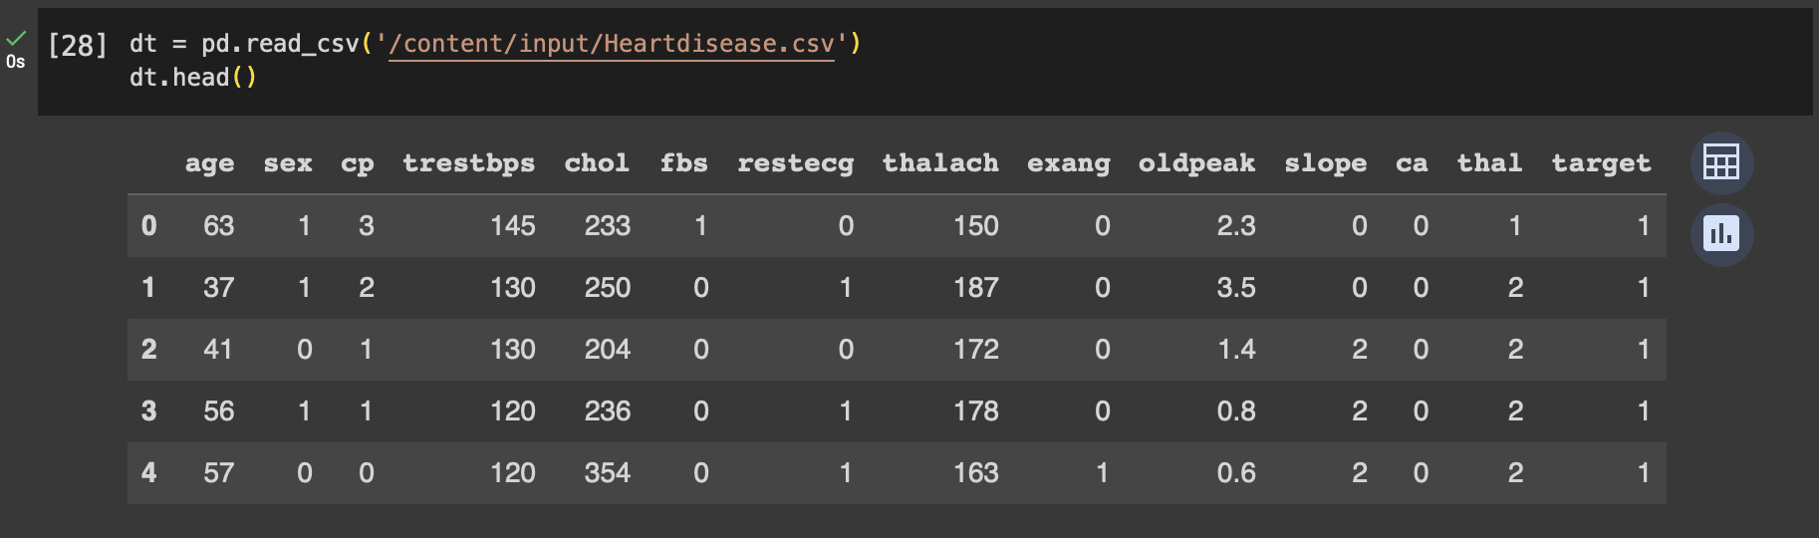
About the Dataset
This dataset has 14 features, one of which is the target feature. Target feature tells us whether a patient has a heart disease or not. About the target feature:
1 = Patient has heart disease
0 = Patient doesn’t have heart disease

Slide 6
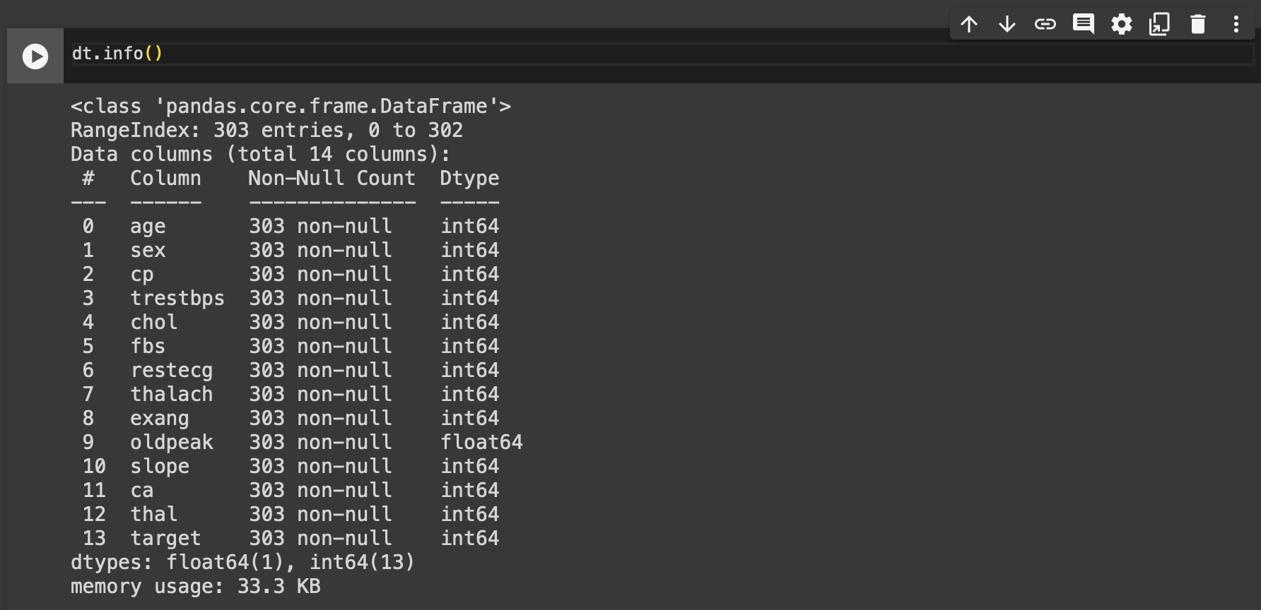
Load and Check Data:

Slide 7


Tools and Libraries
NumPy NumPy (Numerical Python) is an open source Python library that’s used in almost every field of science and engineering. It’s the universal standard for working with numerical data in Python, and it’s at the core of the scientific Python and PyData ecosystems.
Pandas Pandas is a software library written for the Python programming language for data manipulation and analysis. In particular, it offers data structures and operations for manipulating numerical tables and time series.

Slide 8


Tools and Libraries
MatplotLib Matplotlib is a comprehensive library for creating static, animated, and interactive visualisations in Python. Matplotlib makes easy things easy and hard things possible. Some Features are: 1. Create publication quality plots 2. Make interactive figures that can zoom, pan and update.
Seaborn Seaborn is a Python data visualisation library based on matplotlib. It provides a high-level interface for drawing attractive and informative statistical graphics.

Slide 9

Tool and Libraries
Sklearn Scikit-Learn, also known as sklearn is a python library to implement machine learning models and statistical modelling. Through scikit-learn, we can implement various machine learning models for regression, classification, clustering, and statistical tools for analyzing these models.

Slide 10
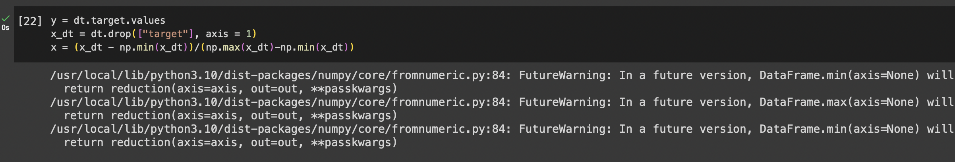
Normalization
Firstly, find any missing value and fill the missing value
In our case, we do not have any missing values.
We need to normalize the data, otherwise one feature may dominate an other feature.

Slide 11
Splitting Of Data
%80 of the data will be used for training the model
%20 of the data will be used for testing the model
We chose random_state = 42 in order to obtain the same rows as train and test at each splitting.

Slide 12
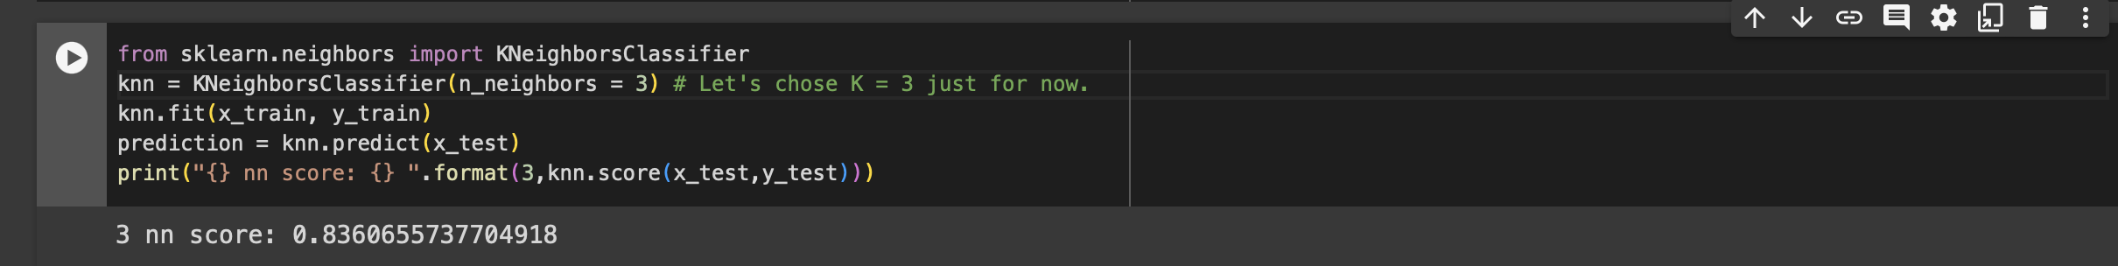
KNN
Now, we implement the KNN Algorithm from the scikit-learn Python Library(also called as sklearn).
There is not a very distinct separation between green and red dots.
The KNN method will try to find the nearest “K” number of points to a selected point and will make a prediction according to the value of the nearest points.

Slide 13
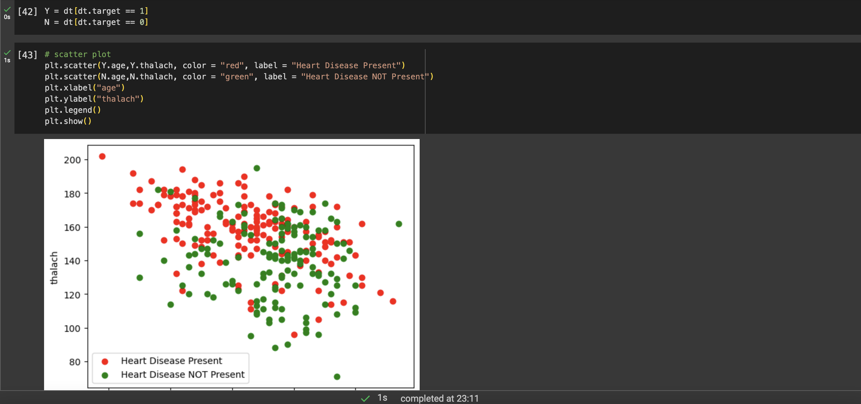
KNN

Slide 14
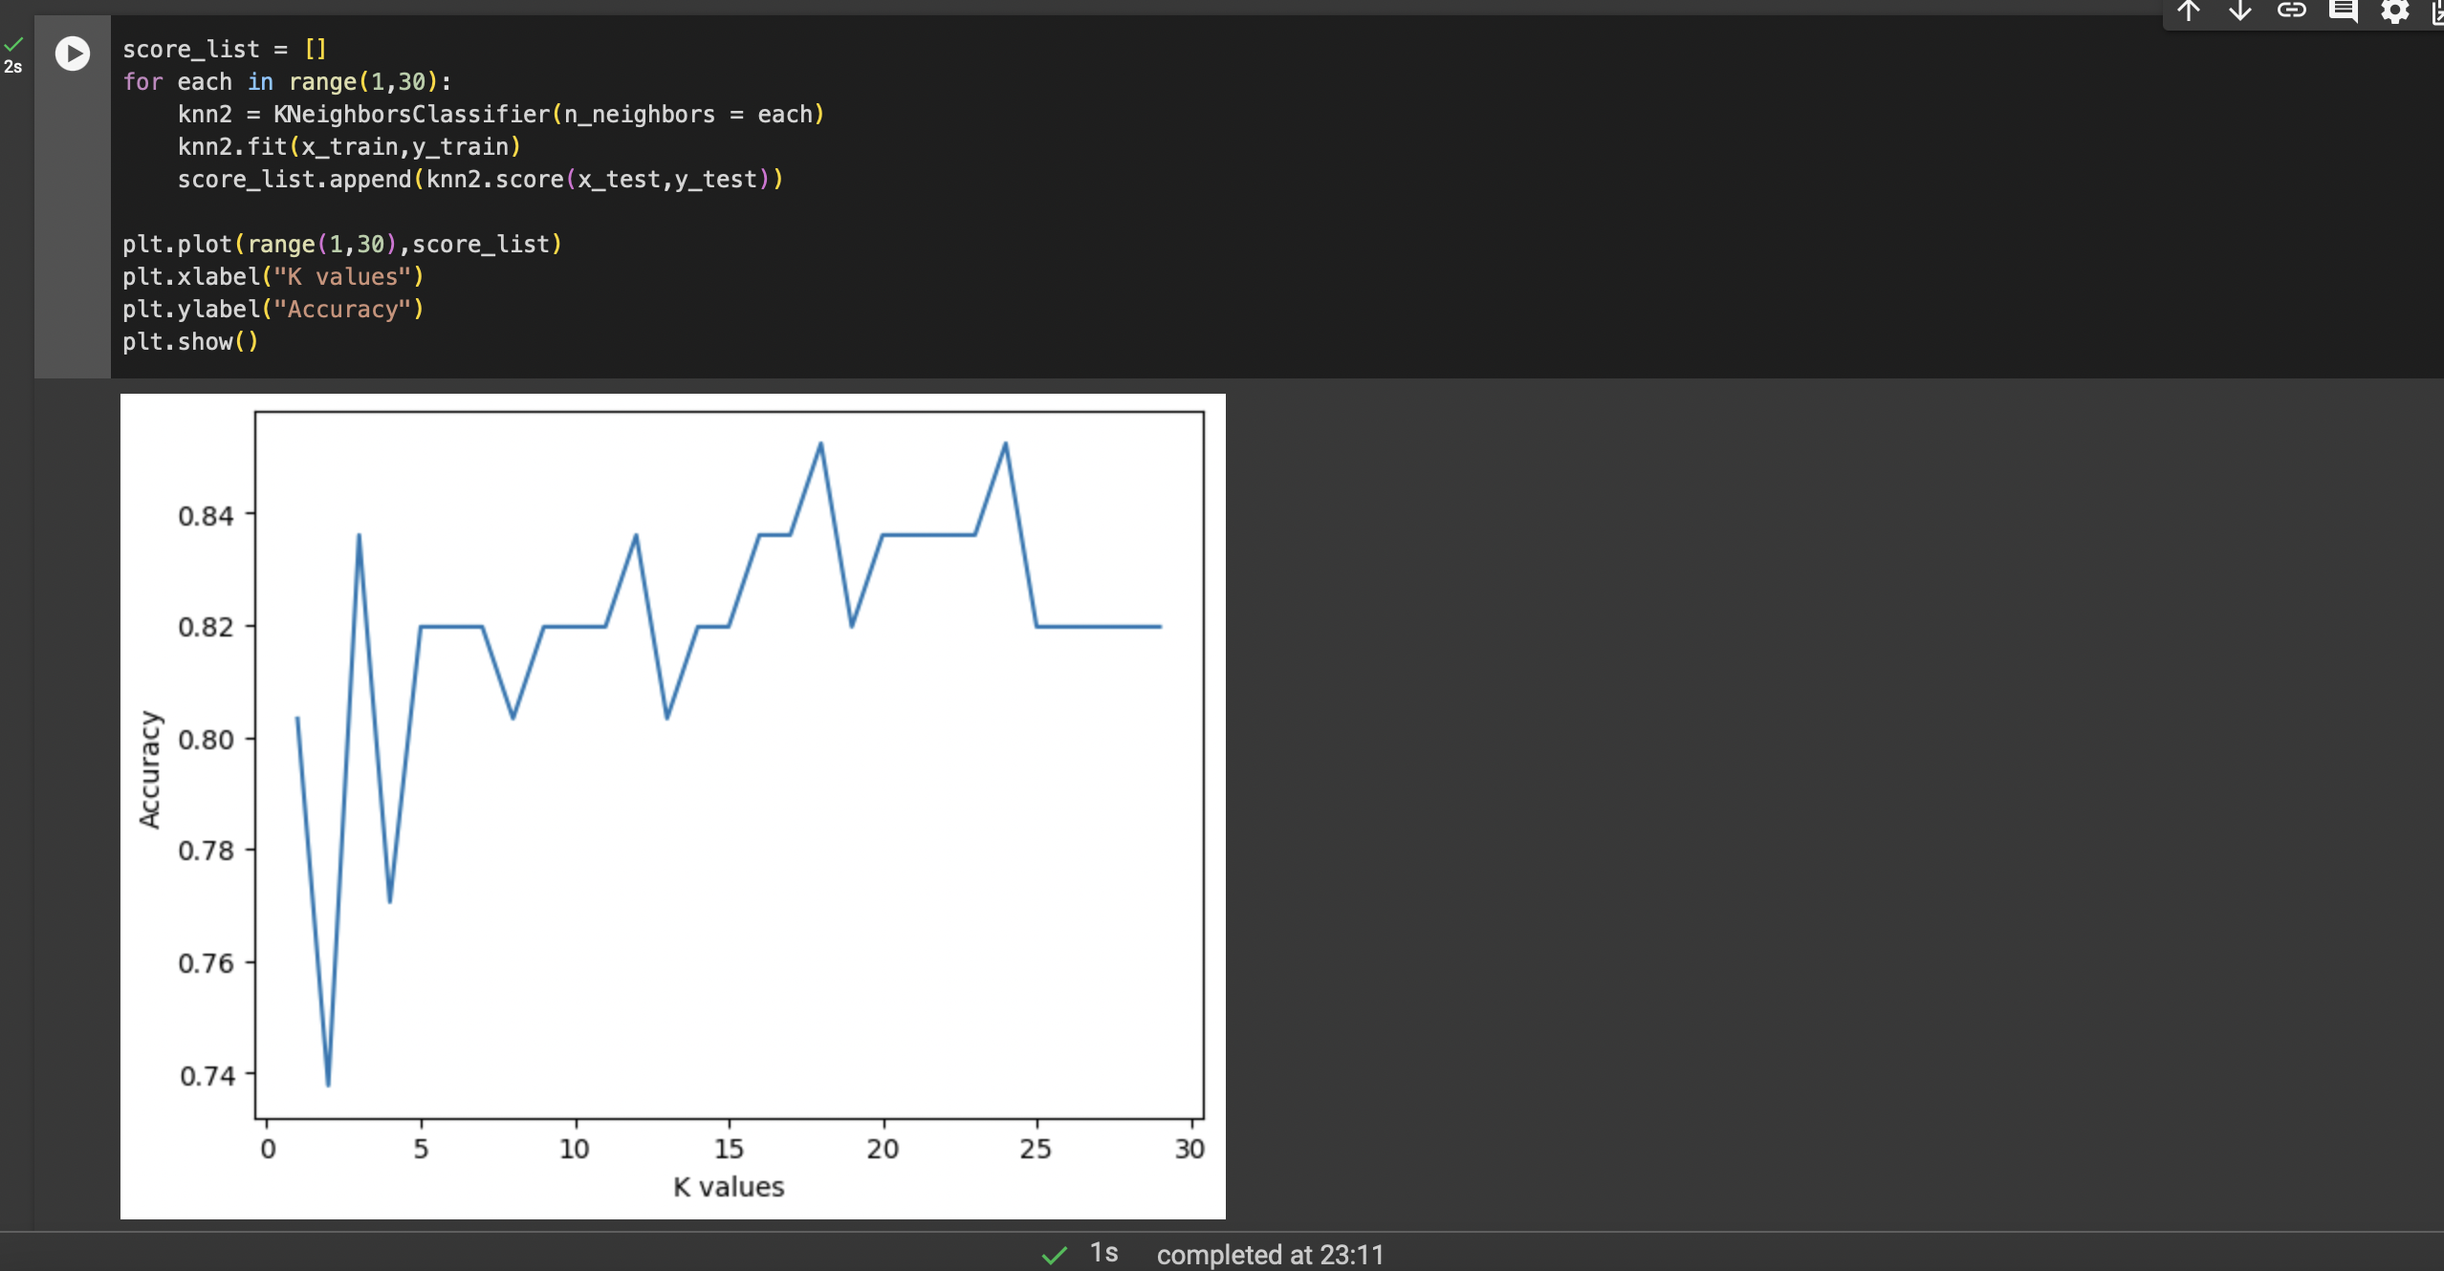
Finding K value
Above, the chosen value for K = 3. The accuracy of the model is 83.6%.
The accuracy of the model will change according to the K value.
Since the aim is to reach the highest accuracy, we need to try different K values and find the best value which gives the highest accuracy.

Slide 15
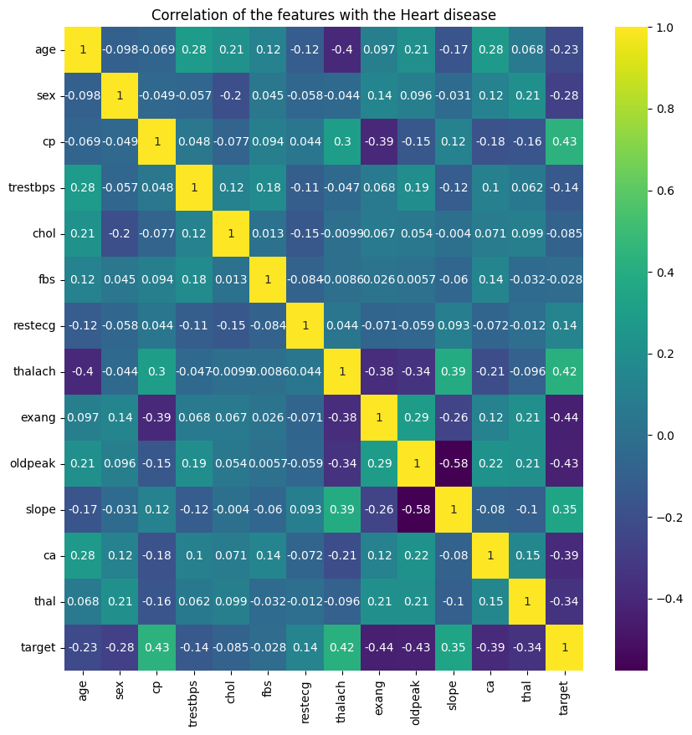
Visualisation (heat map)
It seems that probability of hearth disease (target in this instance) has correlation with:
thal (-)
ca (-)
slope (+)
exang (-)
cp (+)
oldpeak (-)
thalac (+)
It is also seen that:
slope has correlation with:
oldpeak (-)
thalac (+)
exang has correlation with:
cp (-)
thalac (-)
cp has correlation with:
thalac (+)
oldpeak has correlation with:
thalac (+)
thalac has correlation with:
age (-)

Slide 16
Conclusion
The accuracy of KNN model is 85.25%
In comparison to Linear Regression 83.61%
The accuracy of the models may change according to the data

Slide 17
Thank You

